Slide 1
Backpropagation Intuition

Slide 2
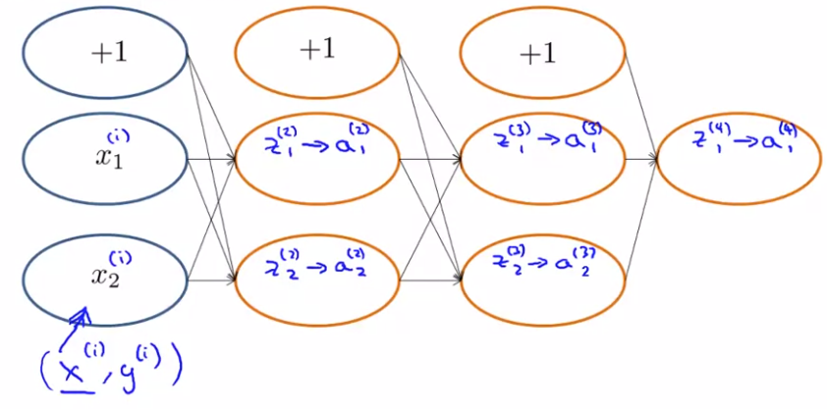
Backpropagation Intuition
Forward Propagation

Slide 3
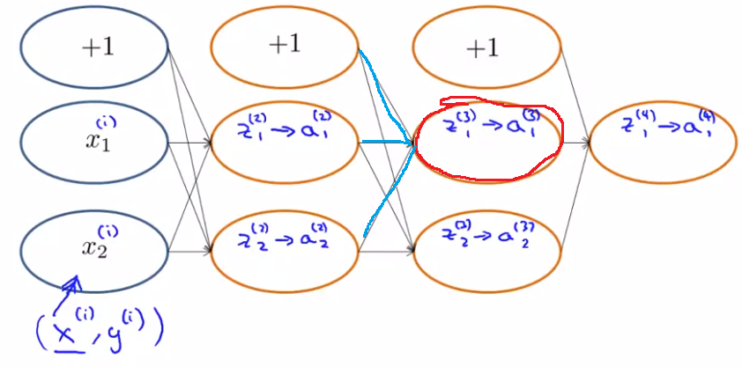
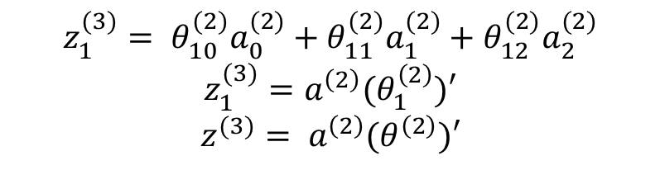
Backpropagation Intuition
Forward Propagation
$$z_{1}^{(3)}= θ_{10}^{(2)}a_{0}^{(2)}+θ_{11}^{(2)}a_{1}^{(2)}+θ_{12}^{(2)}a_{2}^{(2)}$$
$$z_{1}^{(3)}=a^{\left(2\right)}(θ_{1}^{\left(2\right)})′$$
$$z^{(3)}= a^{\left(2\right)}(θ^{\left(2\right)})′$$

Slide 4
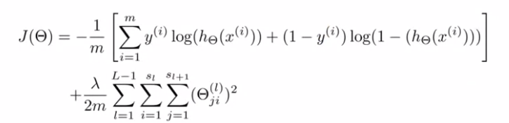


Backpropagation Intuition
Cost function
With single example $x^{(i)},y^{(i)}$, 1 output unit, $λ=0$

Slide 5
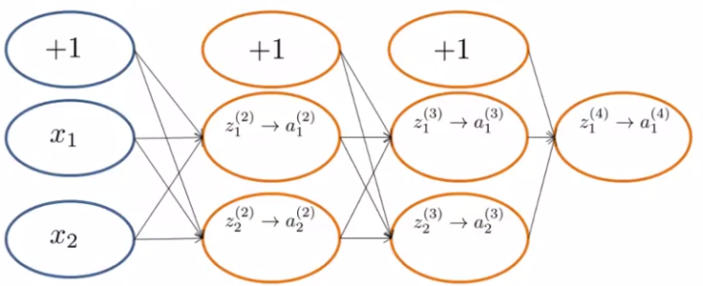
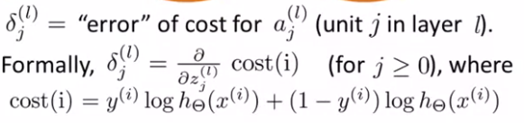
Backpropagation Intuition
Forward propagation

Slide 6
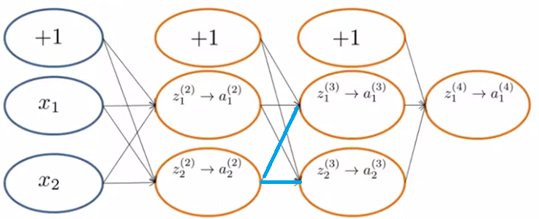


Backpropagation Intuition
Forward propagation
$$θ_{12}^{(2)}$$
$$θ_{22}^{(2)}$$

Slide 7






Backpropagation Intuition
Backward propagation
$$δ_{1}^{(3)}$$
$$θ_{12}^{(2)}$$
$$δ_{2}^{(2)}$$
$$θ_{22}^{(2)}$$
$$δ_{2}^{(3)}$$
$$δ_{2}^{(2)}=δ_{1}^{(3)}θ_{12}^{(2)}+δ_{2}^{(3)}θ_{22}^{(2)}$$

